Slide 1
WELCOME
HIBERNATE PROJECT
‘TO LET – ADDVERTISING AGENCY’
1
DEVELOPED BY SHARIFUL ISLAM
GO TO
1
2
3
4
5
6
7
8
9
+
+
+

Slide 2

SUBMITTED TO
MD. MOSHAHIDUL ISLAM
PROJECT CONSULTANT, J2EE
IDB-BISEW
GO TO
1
2
3
4
5
6
7
8
9
+
+
+

Slide 3
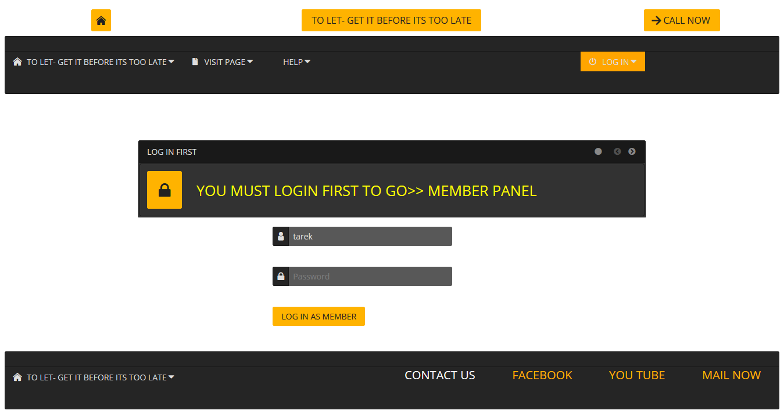
MEMBER NEED TO LOG IN
GO TO
1
2
3
4
5
6
7
8
9
+
+
+

Slide 4
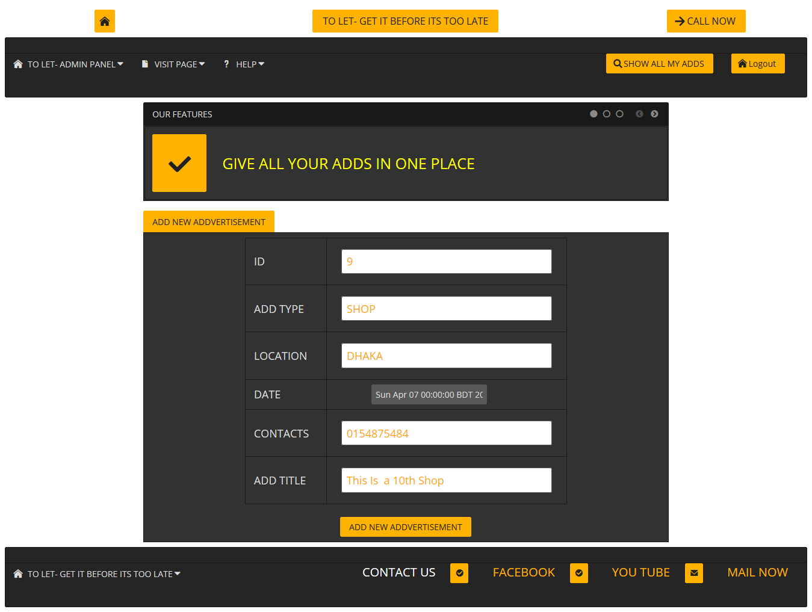
GIVE A NEW ADD OR VIEW
GO TO
1
2
3
4
5
6
7
8
9
+
+
+

Slide 5
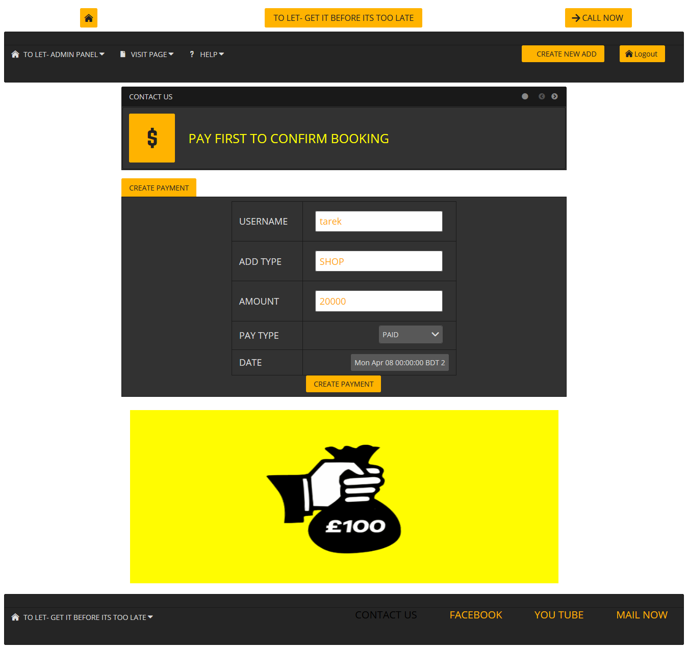
NEED TO PAY BEFORE FINAL
GO TO
1
2
3
4
5
6
7
8
9
+
+
+

Slide 6
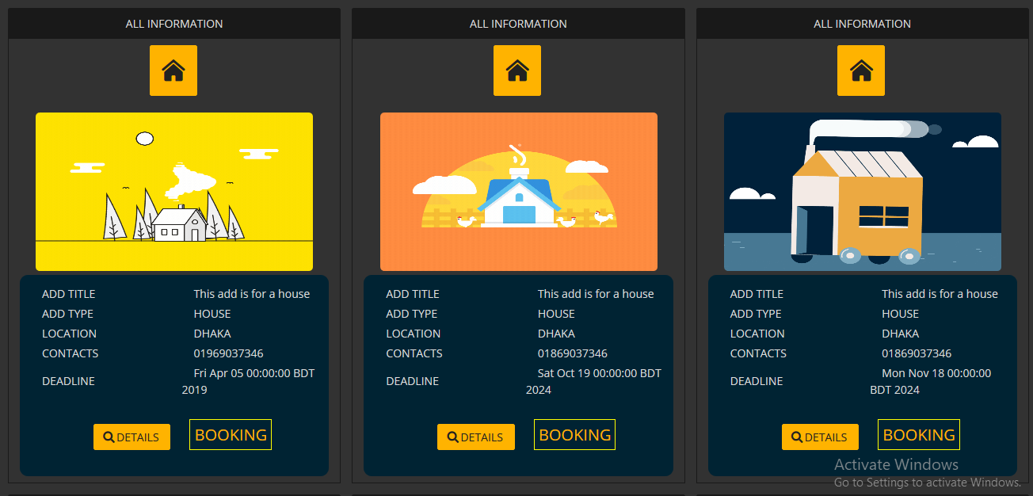
LETS TAKE A LOOK
GO TO
1
2
3
4
5
6
7
8
9
+
+
+

Slide 7

BOOK AN ADD
GO TO
1
2
3
4
5
6
7
8
9
+
+
+

Slide 8
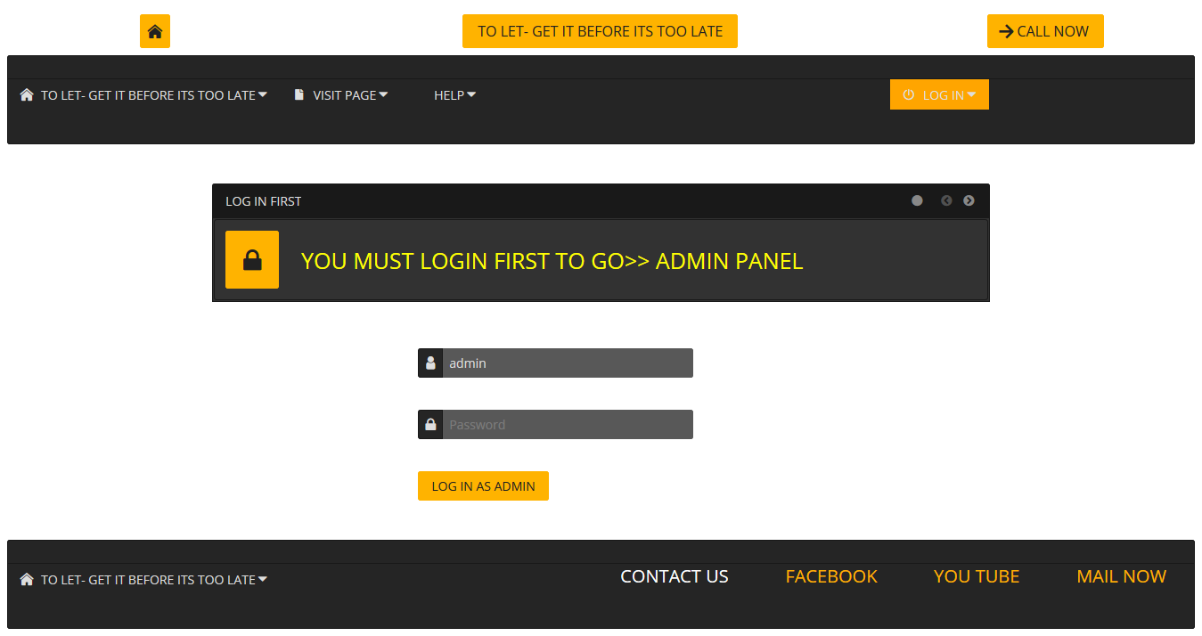
ADMIN LOGIN
GO TO
1
2
3
4
5
6
7
8
9
+
+
+

Slide 9
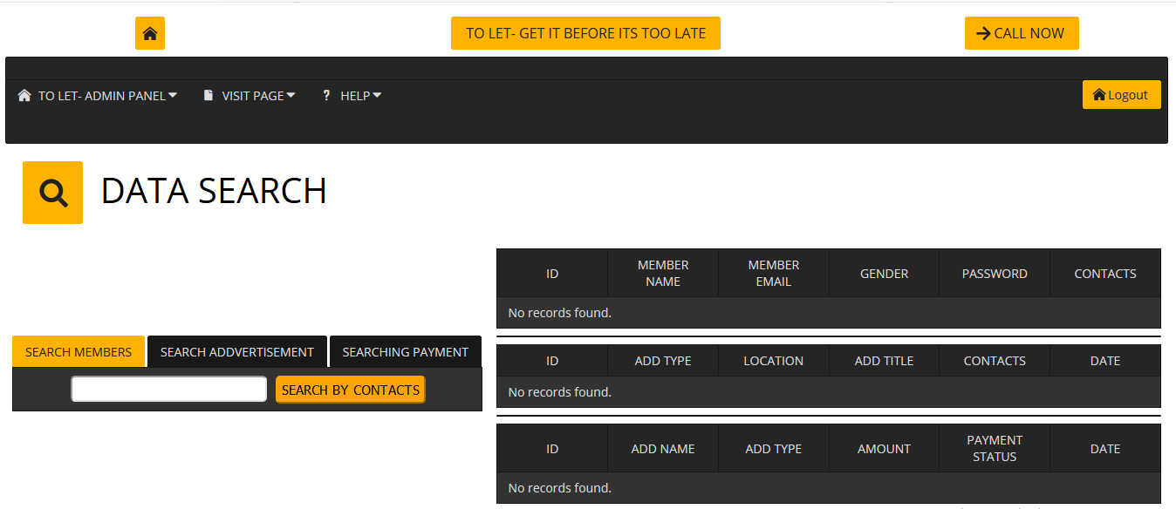
ADMIN SEARCH
GO TO
1
2
3
4
5
6
7
8
9
+
+
+

Slide 10
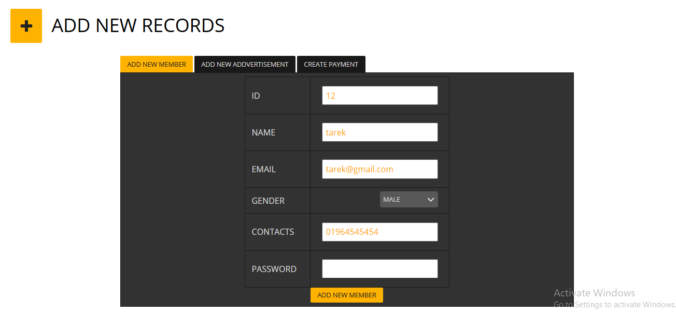
ADMIN ADD NEW
GO TO
1
2
3
4
5
6
7
8
9
+
+
+

Slide 11
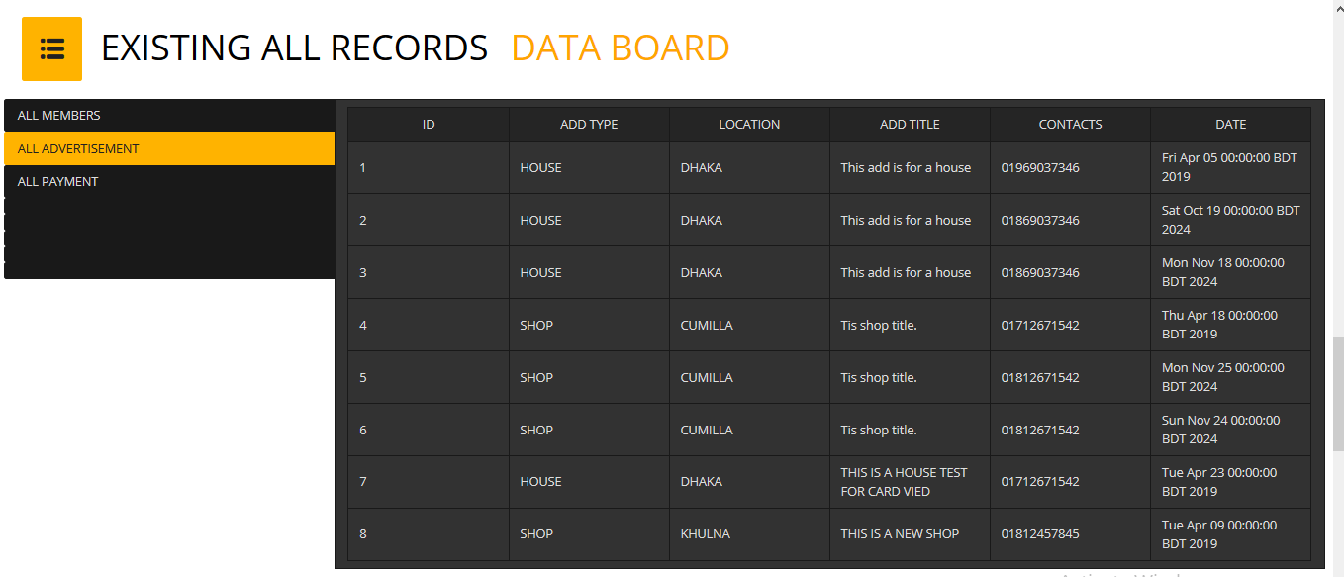
ADMIN PREVIEW BOARD
GO TO
1
2
3
4
5
6
7
8
9
+
+
+

Slide 12
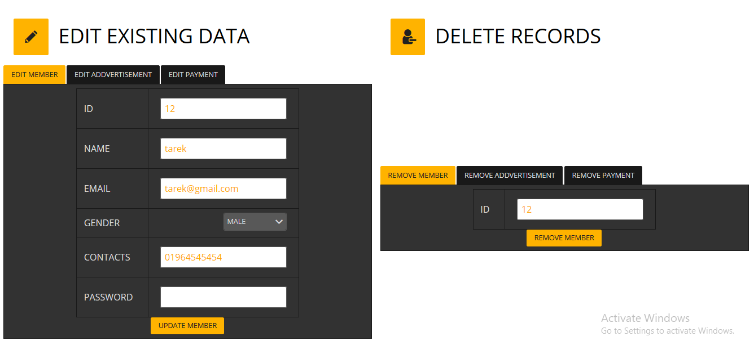
ADMIN DELETE
GO TO
1
2
3
4
5
6
7
8
9
+
+
+

Slide 13



OUR SPECIALITY
BEST SELLER
HOME DELIVERY
SUPPORT
AWERD
AWERD
AWERD
BEST SELLER AWERD 2017
CUSTOMER SATISFACTION 100%
24/7 SUPPORT TEAM SERVICES
GO TO
1
2
3
4
5
6
7
8
9
+
+
+

Slide 14
THANK YOU
VISIT US ANYTIME
GO TO
1
2
3
4
5
6
7
8
9
+
+
+

